Slide 1
Maxle Research Corporation
Innovating Energy Efficiency

Slide 2
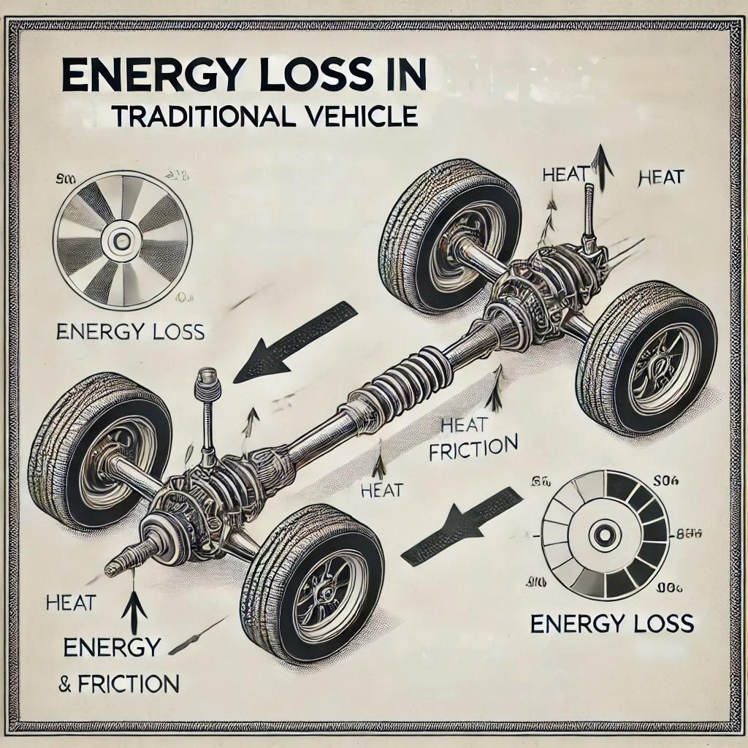
The Problem
Traditional vehicle axles waste kinetic energy.
High fuel consumption and inefficiency in energy recovery.
Environmental impact due to excessive fuel usage.

Slide 3
Our Solution: Maxle
The Maxle generator converts kinetic energy into electrical energy.
Enhances fuel efficiency and reduces environmental impact.
Integrates seamlessly with existing vehicle designs.

Slide 4
Market Opportunity
Market Size: Estimated at $10 billion.
Growth Potential: Rapidly expanding market for energy-efficient technologies.
Target Audience: Automotive manufacturers, electric vehicle companies.

Slide 5
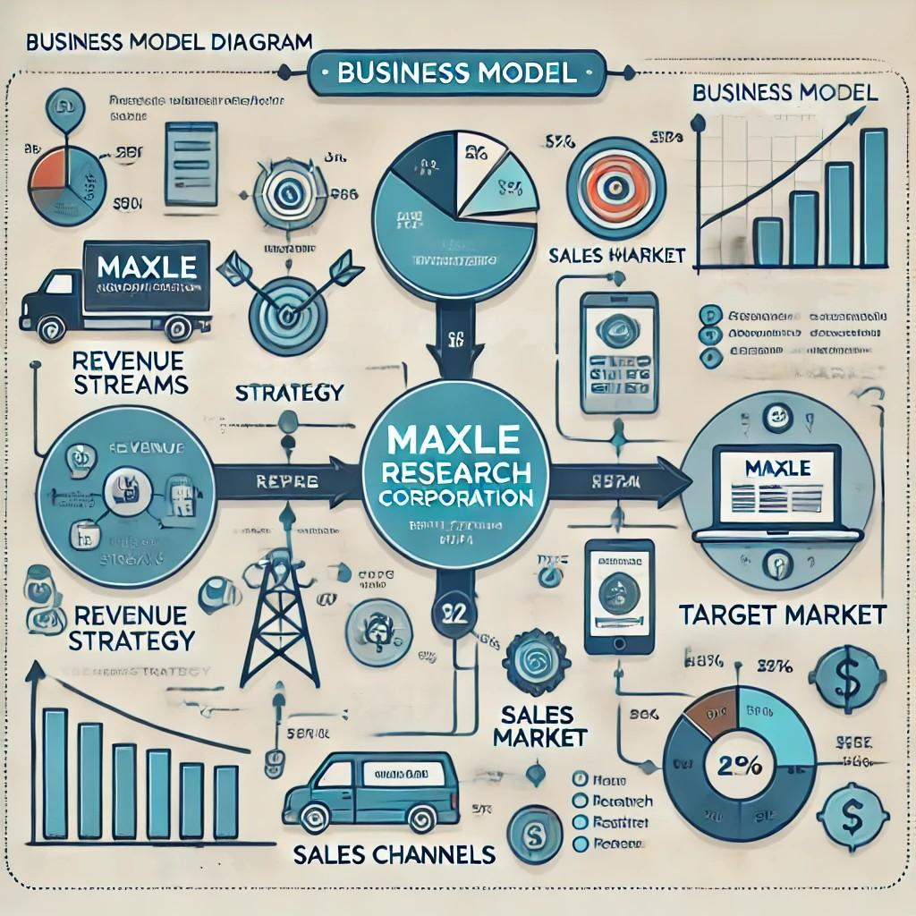
Business Model
Revenue streams: Sale of Maxle generators, licensing, maintenance services.
Pricing strategy: Competitive pricing with high-value proposition.
Sales channels: Direct sales, partnerships with vehicle manufacturers.

Slide 6
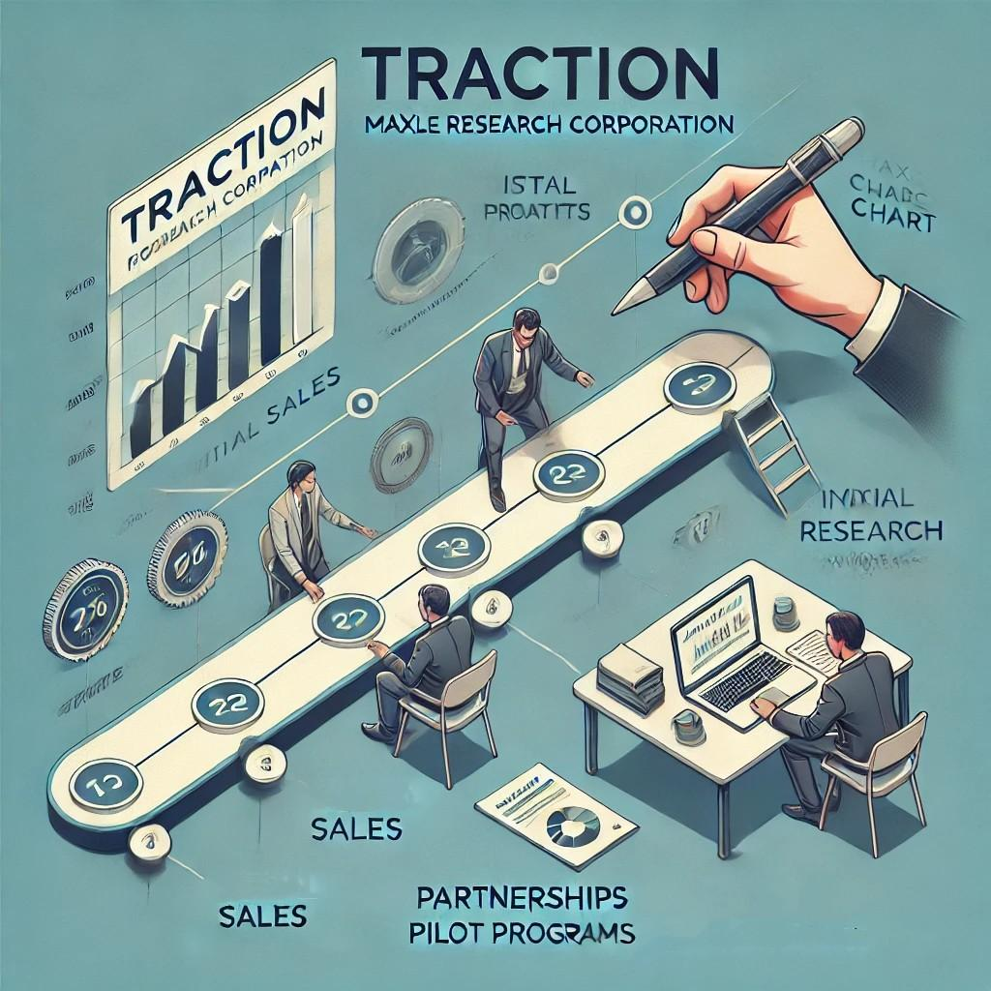
Traction
Key metrics: Initial sales, partnerships, pilot programs.
Milestones: Product development, successful trials, market entry.
Customer testimonials: Positive feedback from pilot customers.

Slide 7
Competitive Landscape
Key competitors: List of main competitors.
Competitive advantages: Unique features and benefits of Maxle.
Market positioning: How Maxle stands out in the market.

Slide 8
Go-to-Market Strategy
Marketing and sales strategy: Plans for customer acquisition and growth.
Channels: Digital marketing, trade shows, partnerships.
Customer acquisition cost (CAC) and lifetime value (LTV).

Slide 9
Financial Projections
Revenue projections for the next 5 years.
Expense forecasts and profitability.
Key financial metrics and milestones.

Slide 10
Team
Management team: Highlight key members and their expertise.
Advisory board: Notable advisors and their contributions.

Slide 11
Funding Requirements
Amount of funding needed.
Allocation of funds for R&D, marketing, operations.
Use of proceeds and expected milestones.

Slide 12
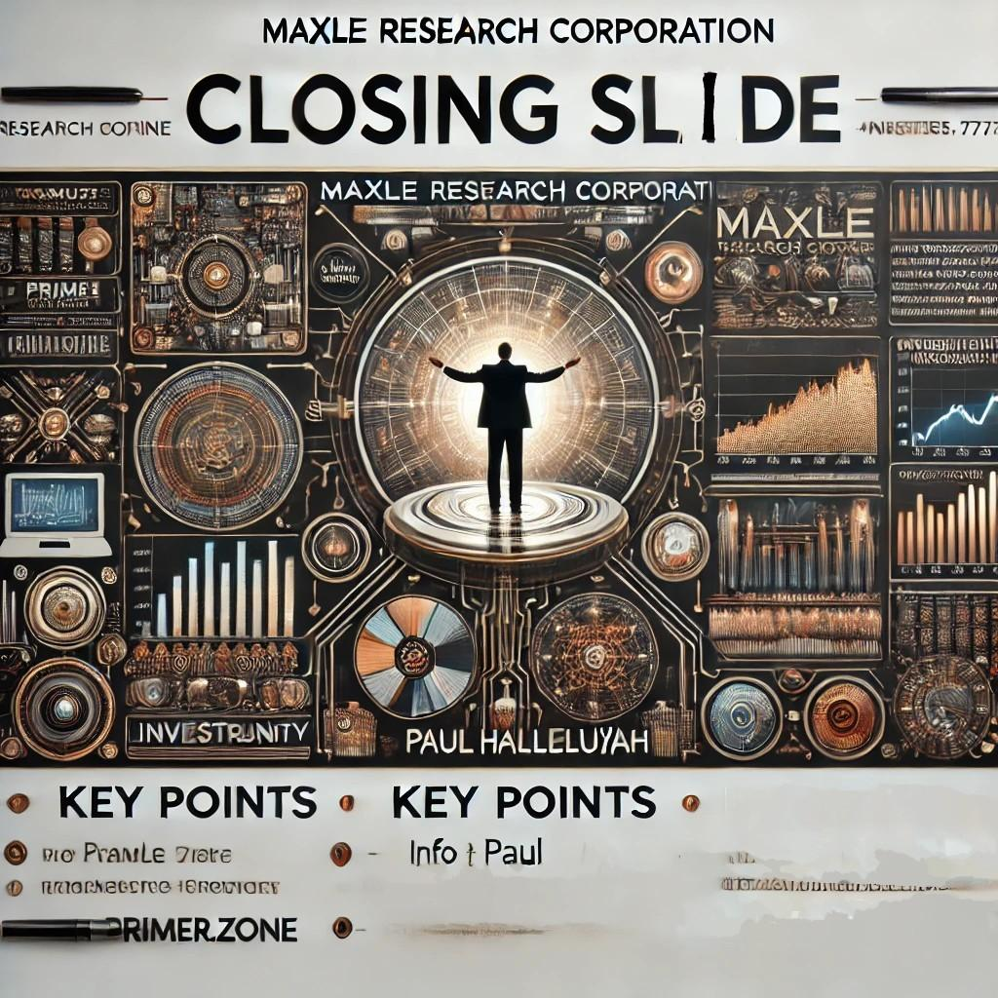
Closing and Q&A
Summary of key points.
Reiterate the investment opportunity.
Open floor for questions and provide contact information.

